Slide 1

Dynamic Web Performance Optimization Measurement Using Machine Learning Analytics
Presentation on
Presented By
Supervised By
Md. Ashikur Rahman
Program: B.Sc. in CSE (HSC)
ID: 0322210105101101
Batch: 20th
Semester: 8th
Session: Spring - 2022
Nahid Hasan
Lecturer
Dept. of CSE, PUB
Department of Computer Science & Engineering
Pundra University of Science & Technology, Bogura – 5800

Slide 2
Outline
Introduction
Literature Review
Data Collection
Results
Conclusion
Objectives
Problem Statement
Methodology
Application
References

Slide 3
Introduction
Core Web Vitals
Labeling Strategies
Model Families
K‑means + LightGBM
Feature Importance
Production Platform

Slide 4
Objectives
Develop an ML model to predict website performance categories
Analyze 22 performance metrics including Core Web Vitals (LCP, CLS, FCP, TTI)
Compare three labeling strategies: Tertile-based, Weighted, and K-means
Evaluate three ML algorithms: Random Forest, LightGBM, and Neural Networks
Create a production-ready web platform for real-time performance analysis

Slide 5
Literature Review
[1] Y. Chen et al., "Predicting website conversion rates using Random Forest" ACM Transactions on the Web, 2019
Contribution:
Applied Random Forest to predict conversion rates from web metrics
Achieved 87% accuracy on e-commerce dataset
Limitations:
Focused on business outcomes, not technical performance
Limited feature set (12 metrics)
Pre-Core Web Vitals era (no LCP, CLS, FCP, TTI analysis)

Slide 6
Literature Review
[2] X. Wang et al., "Linking web performance to user satisfaction using NN" IEEE Transactions on Services Computing, 2022
Contribution:
Deep learning for UX prediction from performance metrics
Achieved 91% accuracy with neural network architecture
Limitations:
Relies on subjective user survey data
High computational complexity without ensemble comparison
No systematic labeling strategy evaluation

Slide 7
Literature Review
[3] R. Kumar and P. Singh, "Web quality assessment using ensemble methods" Journal of Web Engineering, 2021
Contribution:
Ensemble classifiers for website quality categorization
Achieved 89% accuracy with feature engineering
Limitations:
Generic quality metrics (not performance-specific)
No labeling strategy comparison
Classification only (no confidence scoring)

Slide 8
Problem Statement
How can machine learning accurately predict website performance categories to enable proactive optimization?
Key Challenges:
Manual testing is reactive and cannot predict future performance
Complex non-linear relationships between 22+ metrics
No standardized performance categorization methodology
Need for automated, real-time insights
Research Gap:
No existing work systematically compares labeling strategies for Core Web Vitals-based ML prediction
Limited research specifically targeting Google's Core Web Vitals framework

Slide 9
Dataset Overview
Metric | Value
Total Websites | 1,167
Performance Features | 22
Core Web Vitals | 4 (LCP, CLS, FCP, TTI)
Performance Categories | 3 (Good, Average, Weak)
Data Collection Period | July 2025 - December 2025
Collection Method | Selenium, Google Lighthouse API
Train-Test Split | 80-20 (stratified)

Slide 10
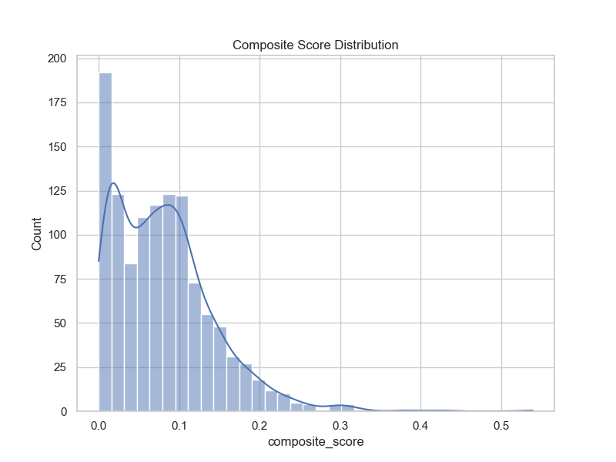
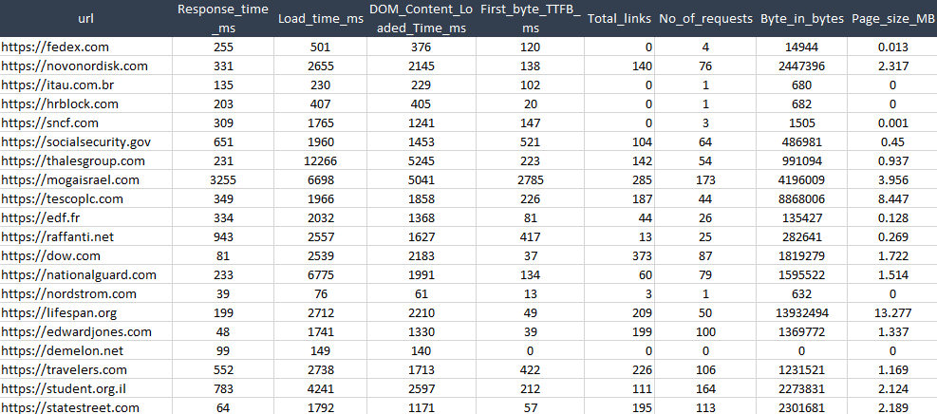
Performance Label Distribution
Figure 1: Balanced dataset: 389 websites per category (Good, Average, Weak)
Figure 2: Dataset Sample

Slide 11
22 Performance Features Analyzed
Response Time | Load Time | DOM Content Loaded | TTFB (First Byte)
Total Links | Request Count | Byte Size | Page Size (MB)
Largest Contentful Paint (LCP) | Cumulative Layout Shift (CLS) | First Contentful Paint (FCP) | Time to Interactive (TTI)
Speed Index | INP | Design Score | JS Execution Time
Main Thread Work | CSS Blocking Time | Broken Links | Start Render Time
Document Complete | Composite Score | - | -

Slide 12
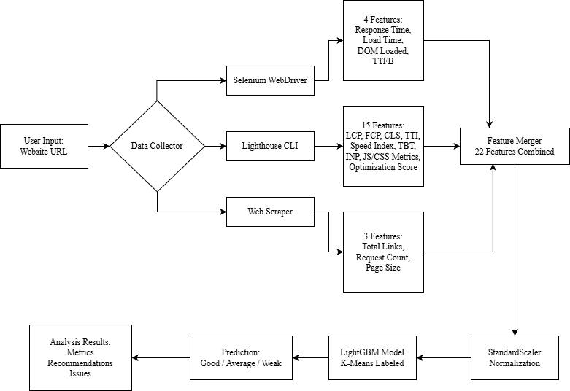
Methodology
Figure 3: Methodology

Slide 13
Three Labeling Strategies Compared
1. Tertile-Based Labeling:
• Equal distribution (33.3% each)
• Based on composite score
• Simple, balanced classes
2. Weighted Composite:
• Expert-defined thresholds
• Weighted importance of metrics
• Domain knowledge driven
3. K-means Clustering (BEST):
• Unsupervised learning approach
• Natural grouping of websites
• Data-driven categorization
• Best performance: 97.86% accuracy
Train-Test Split:
• 80% training, 20% testing
• Stratified sampling
• Random seed: 42 (reproducibility)

Slide 14
Machine Learning Models Evaluated
1. Random Forest (RF):
• Ensemble of decision trees
• Handles non-linear relationships well
• Feature importance extraction
2. LightGBM (Light Gradient Boosting Machine):
• Gradient boosting framework
• Fast training, high efficiency
• Best overall performance (97.86% accuracy)
3. Keras Neural Network:
• Deep learning approach
• Multi-layer perceptron architecture
• Captures complex patterns
Total Models Trained: 9 (3 strategies × 3 algorithms)

Slide 15
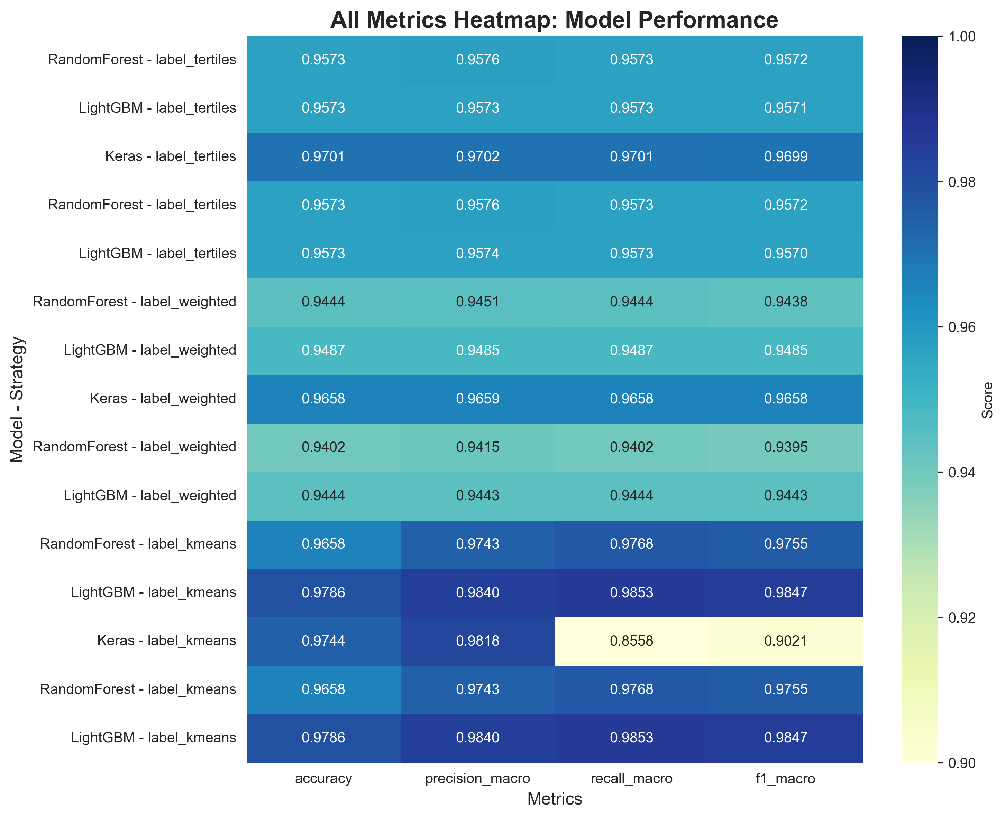
Results: Model Performance
Figure 4: All metrics heatmap

Slide 16
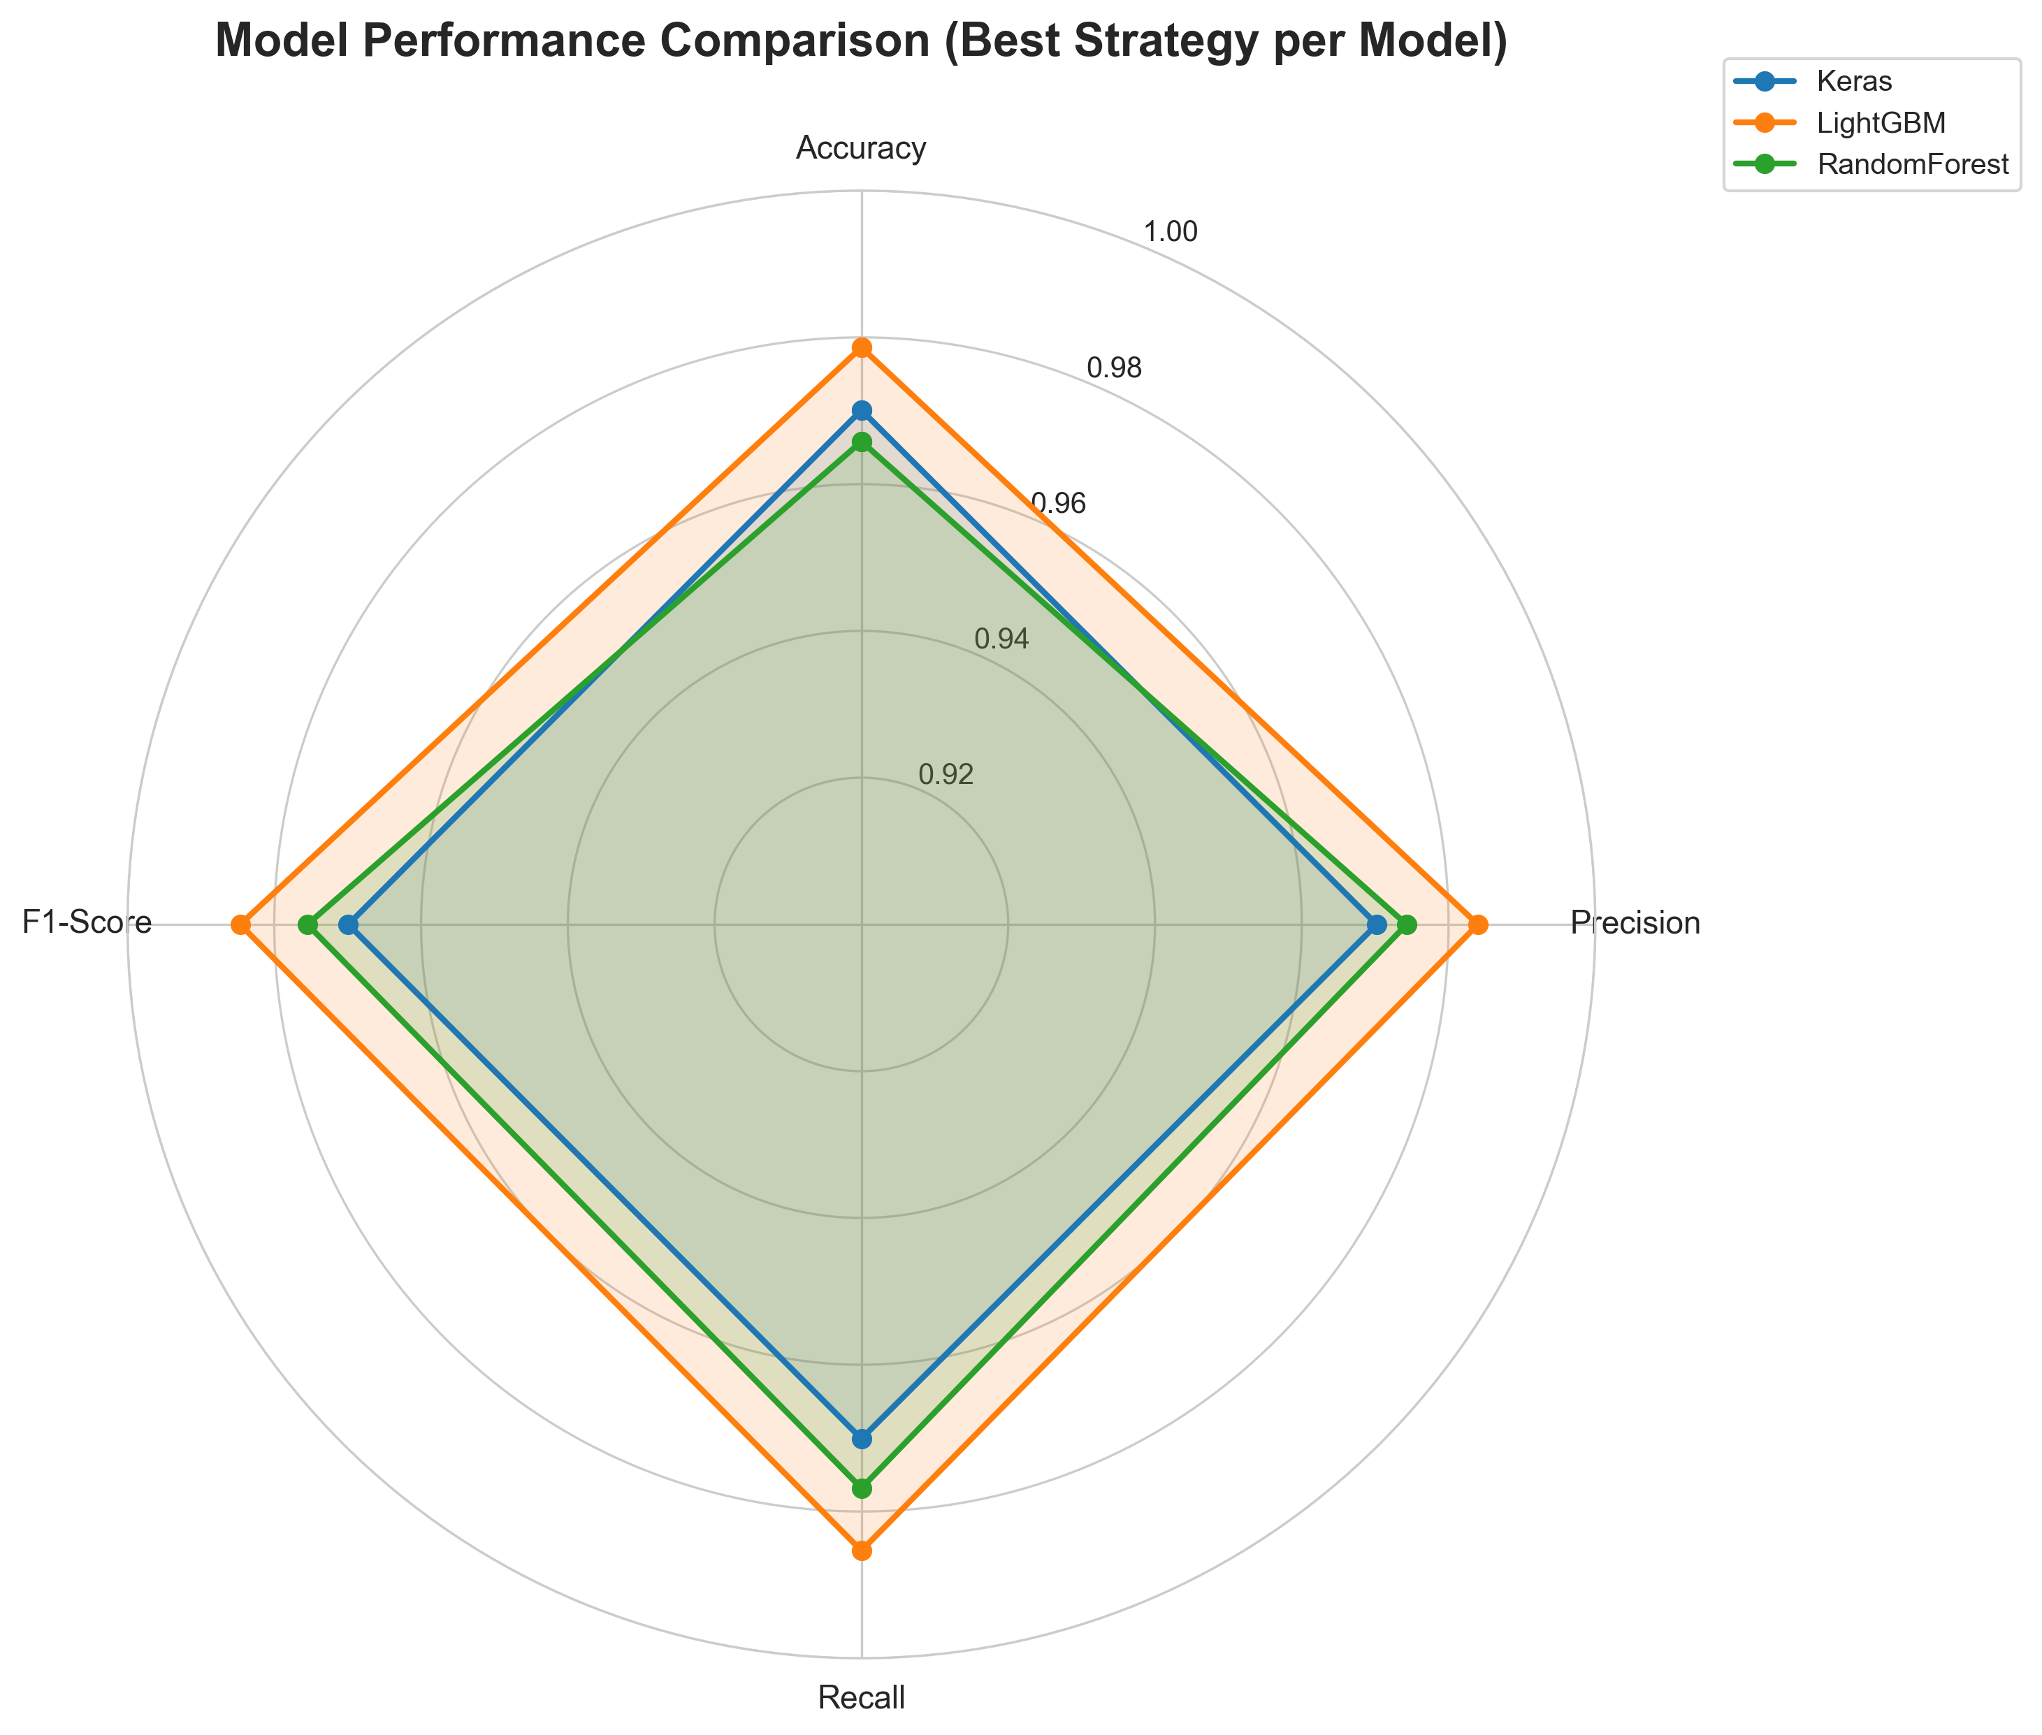
Model Accuracy Comparison
Key Findings:
K-means labeling consistently outperforms other strategies
LightGBM achieves best balance of all metrics
All models exceed 94% accuracy threshold
Minimal variance in precision/recall (balanced predictions)
Neural networks show competitive performance on tertile strategy
Figure 5: Model Performance Comparison

Slide 17
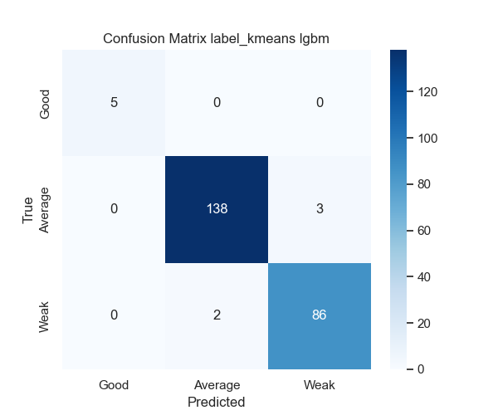
LightGBM + K-means Confusion Matrix
LightGBM + K-means Clustering
• High accuracy across all three categories
• Minimal misclassification
• Strong diagonal pattern indicates excellent predictions
• Balanced performance (no class bias)
Figure 6: LightGBM + K-means Confusion Matrix

Slide 18
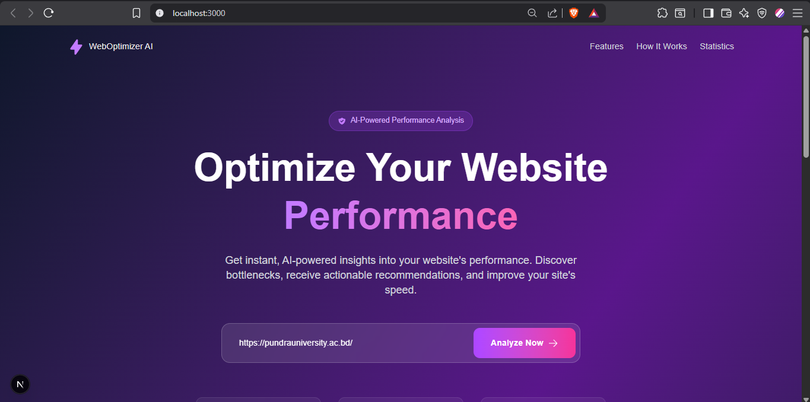

Real-World Application: Web Platform
Figure 7: Home page URL Input section
Figure 8: Home page Footer section
Technology Stack:
• Frontend: Next.js 16, TypeScript, Tailwind CSS • Backend: Python FastAPI + Node.js REST API
• ML: scikit-learn, LightGBM, TensorFlow/Keras

Slide 19
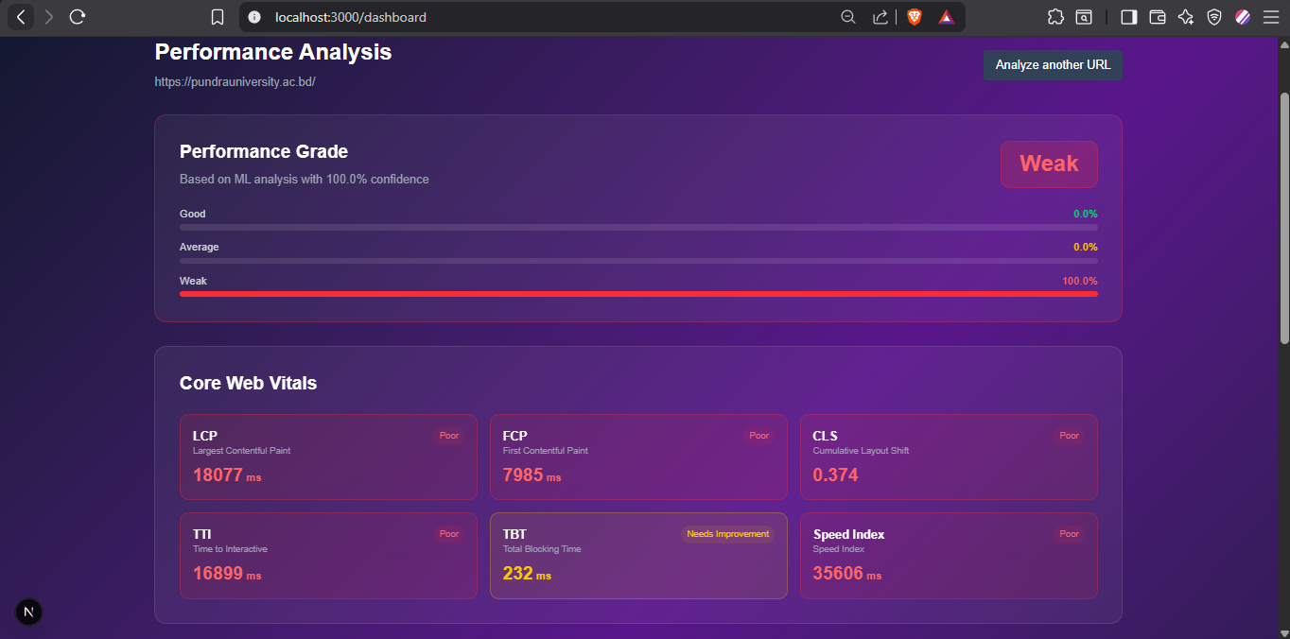
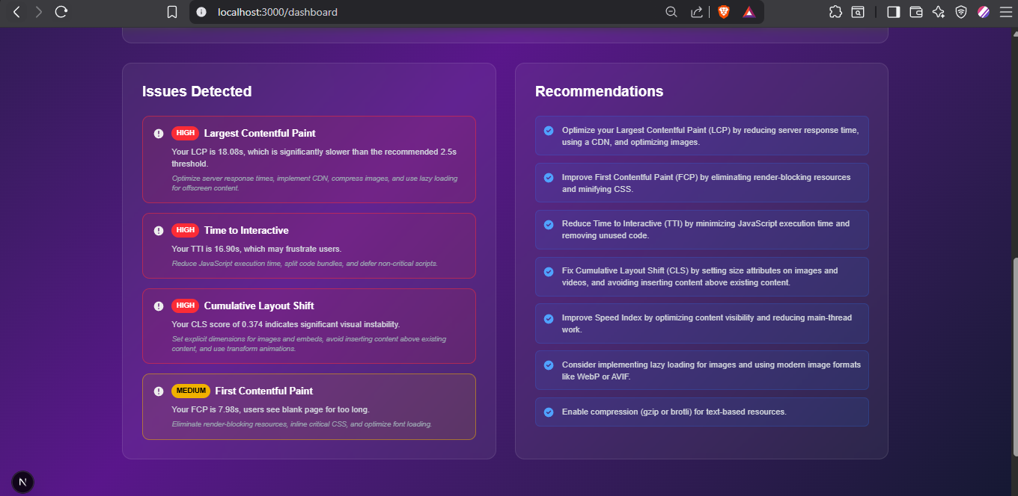
Web Platform
Figure 9: Dashboard Performance Analysis Section
Figure 9: Dashboard Recommendations Section
Key Features:
• Real-time performance analysis
• Interactive dashboard with Core Web Vitals visualization
• Performance grade: Good / Average / Weak
• Actionable recommendations prioritized by impact
• Mobile and desktop responsive design

Slide 20
Future Directions
Technical Enhancements:
• Real-time monitoring with continuous model retraining
• Mobile vs Desktop performance prediction
• Multi-regional analysis (geographic performance)
• Integration with CI/CD pipelines
• Explainable AI for recommendation generation

Slide 21
Conclusion & Key Contributions
Research Achievements:
98.47% F1-score - highest in Core Web Vitals ML research
Comprehensive analysis of 1,167 real-world websites
Systematic evaluation: 3 labeling strategies × 3 ML algorithms
K-means clustering identified as optimal labeling approach
Novel Contributions:
First comprehensive ML study specifically targeting Core Web Vitals
Production-ready web platform
Three labeling strategies rigorously evaluated
Practical Impact:
Enables proactive website optimization
Reduces manual performance testing time by 90%
Provides actionable insights for developers and businesses

Slide 22
References
[1] Y. Chen et al., "Predicting website conversion rates using machine learning,“ ACM Transactions on the Web, vol. 13, no. 2, pp. 1-28, 2019.
[2] X. Wang et al., "Linking web performance to user satisfaction: A neural network approach," IEEE Trans. Services Computing, vol. 15, no. 3, 2022.
[3] R. Kumar and P. Singh, "Web quality assessment using ensemble methods,“ Journal of Web Engineering, vol. 20, no. 4, pp. 567-590, 2021.
[4] Google, "Web Vitals," web.dev, 2020-2024. [Online]. Available: https://web.dev/vitals/
[5] G. Ke et al., "LightGBM: A highly efficient gradient boosting decision tree,“ in Proc. NIPS, 2017, pp. 3146-3154.

Slide 23
Thank You.
Any Questions?

